Slide 1
^{Live online presentations} ^{helping you create a culture} ^{of a fully funded ministry.}

Slide 2
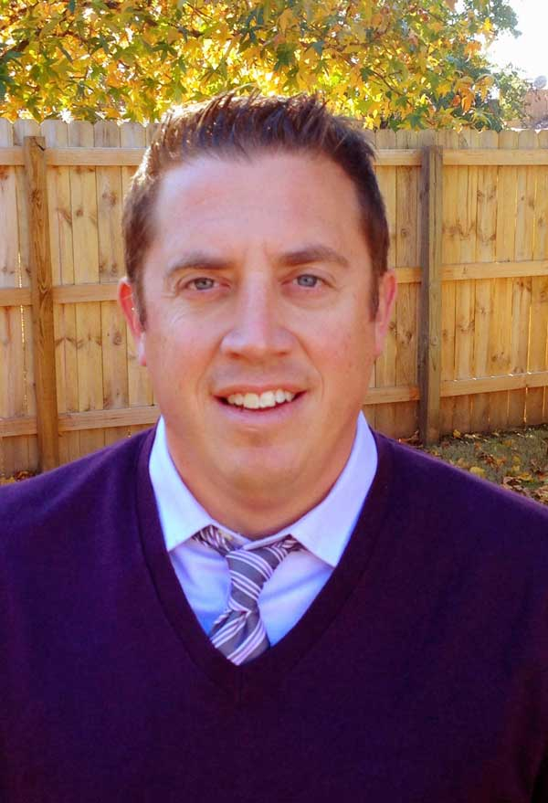
Moderator Introduction
Aaron J. Babyar – SRS Managing Director

Slide 3
Introduction
SRS Vision
We want to flood the nations with
Spiritually healthy,
Vision-driven,
Fully funded Great Commission workers

Slide 4
Introduction
Our Goal
SRS provides solutions to help your staff overcome obstacles, maintain a God-centered perspective, and apply proven strategies to personal support raising.
We want to help you create a culture of a fully funded ministry for:
Recruits
New Staff
Veteran Staff
Support raising trainers and coaches

Slide 5
Introduction
Ongoing Benefits of the SRS Network
Monthly Webinars
Training for you as facilitators (SRS Conference: Oct. 20-22)
Opportunity to utilize SRS Bootcamp curriculum
Coming Soon:
Upcoming online prep with participant progress tracking
Catapult Series
Past Webinar Library
Audit Survey

Slide 6
Come See Us!
We’re going to be at MissioNexus!
Sept. 24-26
We want to meet with you!
Email Kayla to set up a time.

Slide 7
Stop and Mark Your Calendar!
SRS National Conference — Oct. 20-22
*If you would like to certify more facilitators, there will be a public Bootcamp immediately preceding the National Conference. There will also be an SRS Certified Facilitator Training track during the conference.

Slide 8
Stop and Mark Your Calendar!
Last Tuesday of each month 1 p.m. CST
Please create a recurring event in your calendar
You’ll receive an email invite monthly, please plan to ACCEPT it each time

Slide 9
^{Prayer}

Slide 10
Questions
During the presentation, please submit your questions for the upcoming Q&A time

Slide 11
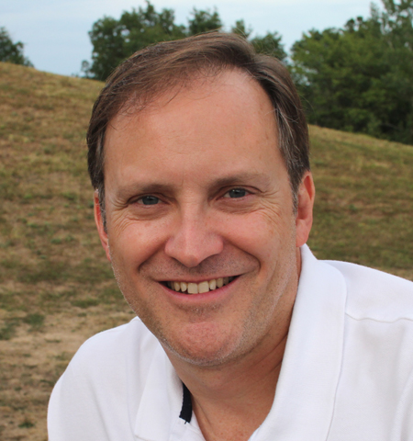
Presenter Introduction
David Flynn – Center for Mission Mobilization

Slide 12
How to Manage Yourself During Support Raising and Long-Term Team Maintenance

Slide 13
Managing Yourself During Support Raising
Therefore, my dear friends, as you have always obeyed—not only in my presence, but now much more in my absence—continue to work out your salvation with fear and trembling, for it is God who works in you to will and to act in order to fulfill his good purpose.
- Philippians 2:12-13

Slide 14
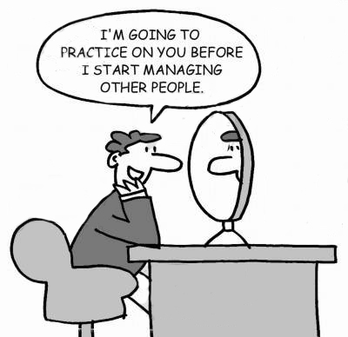
Managing Yourself During Support Raising

Slide 15
Managing Yourself During Support Raising
As Leaders and Support Trainers – What to Model and Teach
Reduce potential stressors before you begin
Family
Ministry
Church
Finances
Deadlines
Friendships
Phone Calls
Time
Emails
Exercise

Slide 16
Managing Yourself During Support Raising
As Leaders and Support Trainers – What to Model and Teach
Reduce potential stressors before you begin
Establish SOLID accountability
ACCOUNTABILITY
THE GLUE THAT TIES COMMITMENT TO THE RESULT

Slide 17
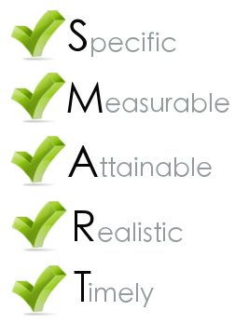
Managing Yourself During Support Raising
As Leaders and Support Trainers – What to Model and Teach
Reduce potential stressors before you begin
Establish solid accountability
Set SMART goals

Slide 18
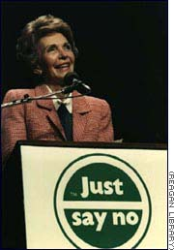
Managing Yourself During Support Raising
As Leaders and Support Trainers – What to Model and Teach
Reduce potential stressors before you begin
Establish solid accountability
Set SMART goals
Just say NO

Slide 19
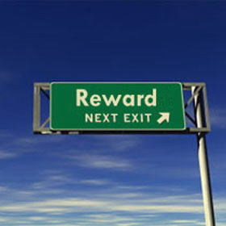
Managing Yourself During Support Raising
As Leaders and Support Trainers – What to Model and Teach
Reduce potential stressors before you begin
Establish solid accountability
Set SMART goals
Just say NO
Reward yourself

Slide 20
Long-Term Maintenance
As Leaders and Support Trainers – What to Model and Teach
Constant Contact Mode

Slide 21
Long-Term Maintenance
As Leaders and Support Trainers – What to Model and Teach
Constant Contact Mode
Have a Plan

Slide 22
Long-Term Maintenance
As Leaders and Support Trainers – What to Model and Teach
Constant Contact Mode
Have a Plan
Maximize Travel

Slide 23
Long-Term Maintenance
As Leaders and Support Trainers – What to Model and Teach
Constant Contact Mode
Have a Plan
Maximize Travel
Social Media Touchpoints

Slide 24
Long-Term Maintenance
As Leaders and Support Trainers – What to Model and Teach
Constant Contact Mode
Have a Plan
Maximize Travel
Social Media Touchpoints
Tithing the Time

Slide 25
Managing Yourself During Support Raising
As Leaders and Support Trainers – What to Secure and Establish
Checking on Team Support levels

Slide 26
Managing Yourself During Support Raising
As Leaders and Support Trainers – What to Secure and Establish
Checking on Team Support levels
Staff Reporting on Support Maintenance Time

Slide 27
Managing Yourself During Support Raising
As Leaders and Support Trainers – What to Secure and Establish
Checking on Team Support levels
Staff reporting on Support Maintenance Time
Allocating Time for SMD

Slide 28
Managing Yourself During Support Raising
As Leaders and Support Trainers – What to Secure and Establish
Checking on Team Support Levels
Staff Reporting on Support Maintenance Time
Allocating Time for SMD
Share Staff Experiences

Slide 29
[Shad]
david.flynn@mobilization.org
(479)409-1594

Slide 30
Managing Yourself During Support Raising
^{Q&A}
As Leaders and Support Trainers – What to Secure and Establish
Checking on Team Support levels
Staff reporting on support maintenance time
Allocating time for SMD
Share staff experiences

Slide 31
Closing
Join us next month on
September 29 @1pm CST

