Slide 1
^{Live online presentations} ^{helping you create a culture} ^{of a fully funded ministry.}

Slide 2
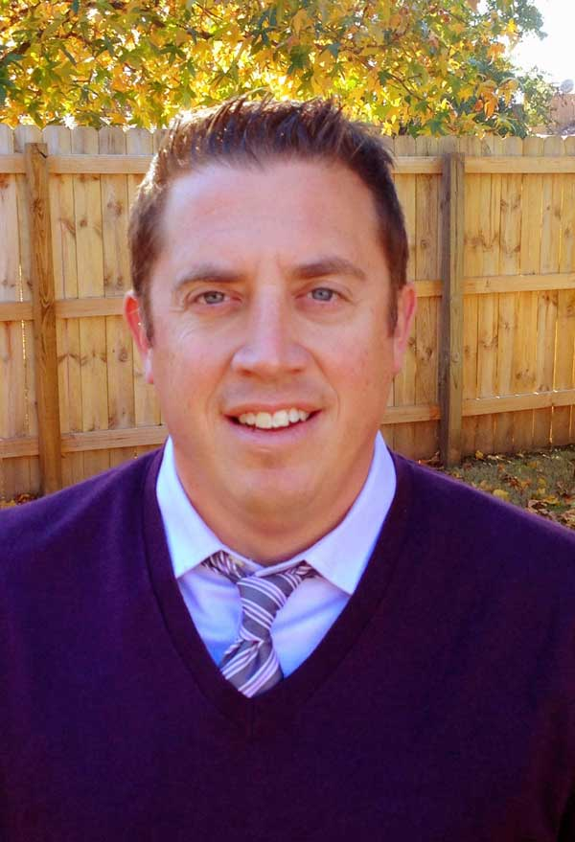
Moderator Introduction
Aaron J. Babyar – SRS Managing Director

Slide 3
Introduction
SRS Vision
We want to flood the nations with
Spiritually healthy,
Vision-driven,
Fully funded Great Commission workers

Slide 4
Introduction
Our Goal
SRS provides solutions to help your staff overcome obstacles, maintain a God-centered perspective, and apply proven strategies to personal support raising.
We want to help you create a culture of a fully funded ministry for:
Recruits
New Staff
Veteran Staff
Support raising trainers and coaches

Slide 5
Introduction
Ongoing Benefits of the SRS Network
Monthly Webinars
Training for you as facilitators (SRS Conference: Oct. 20-22)
Opportunity to utilize SRS Bootcamp curriculum
Coming Soon:
Upcoming online prep with participant progress tracking
Catapult Series
Past Webinar Library
Audit survey

Slide 6
Stop and Mark Your Calendar!
SRS Network Conference — Oct. 20-22
*If you would like to certify more facilitators, there will be a public Bootcamp immediately preceding the National Conference. There will also be an SRS Certified Facilitator Training track during the conference.

Slide 7
Stop and Mark Your Calendar!
Last Tuesday of each month 1 p.m. CST
Please create a recurring event in your calendar
You’ll receive an email invite monthly, please plan to ACCEPT it each time

Slide 8
^{Prayer}

Slide 9
Questions
During the presentation, please submit your questions for the upcoming Q&A time

Slide 10
2 Timothy 3:15-17 (ESV)
….and how from childhood you have been acquainted with the sacred writings, which are able to make you wise for salvation through faith in Christ Jesus. All Scripture is breathed out by God and profitable for teaching, for reproof, for correction, and for training in righteousness, that the man of God may be complete, equipped for every good work.

Slide 11
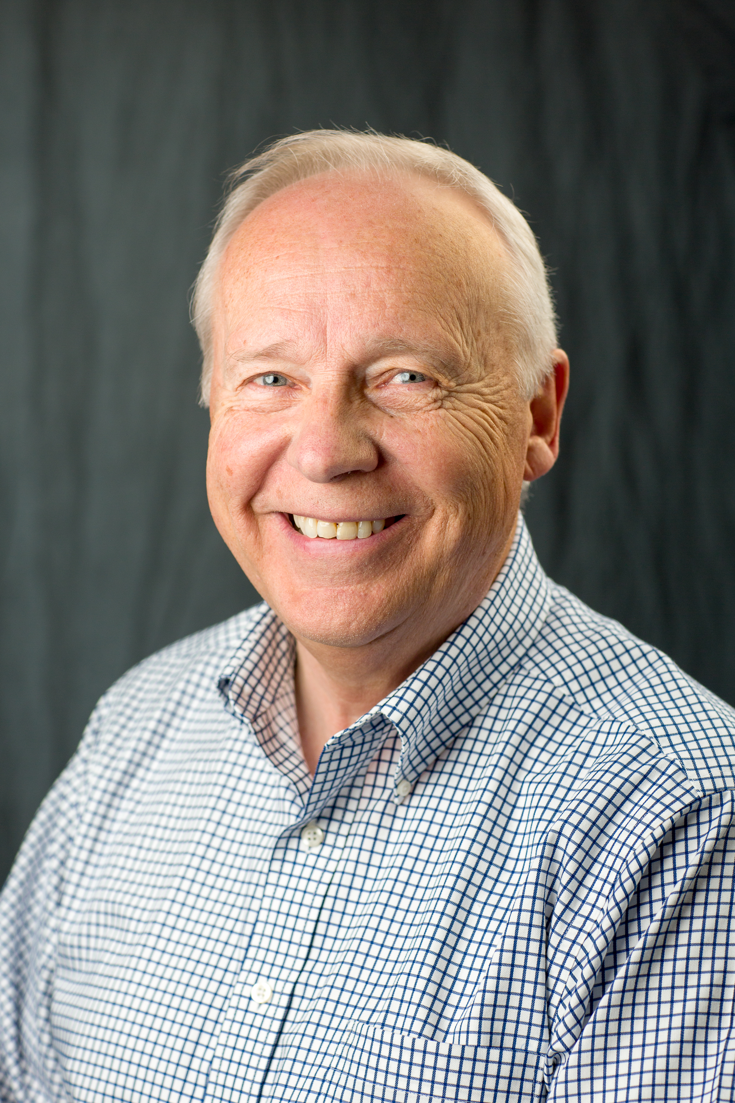
Presenter Introduction
Scott Morton – The Navigators

Slide 12
False Theologies in Personal Support Raising (and other stuff that doesn’t work!)

Slide 13
Handling False Theologies in Fundraising
George Mueller gone bad
Scarcity mentality
Just work hard
It’s all about the Benjamin’s
Duty rather than a privilege

Slide 14
Other Tactics That Don’t Work
Visibility = fundraising?
Social media alone?
Narrow mailing list?

Slide 15
Coaching Basics
Where are you now—data and emotions?
Where do you need to be?
How will you get there?

Slide 16
Coaching Lessons
Real issue is not the first issue
Have a plan but be flexible
Don’t close without the Bible

Slide 17
Conclusion
The twelve were with Him, and also some women who had been healed of evil spirits and sicknesses: Mary who was called Magdalene, from whom seven demons had gone out, and Joanna the wife of Chuza, Herod’s steward, and Susanna, and many others who were contributing to their support out of their private means.
Luke 8:1-3

Slide 18
For More Help
To find more resources by Scott Morton visit
www.scottmorton.net

Slide 19
^{Q&A}

Slide 20
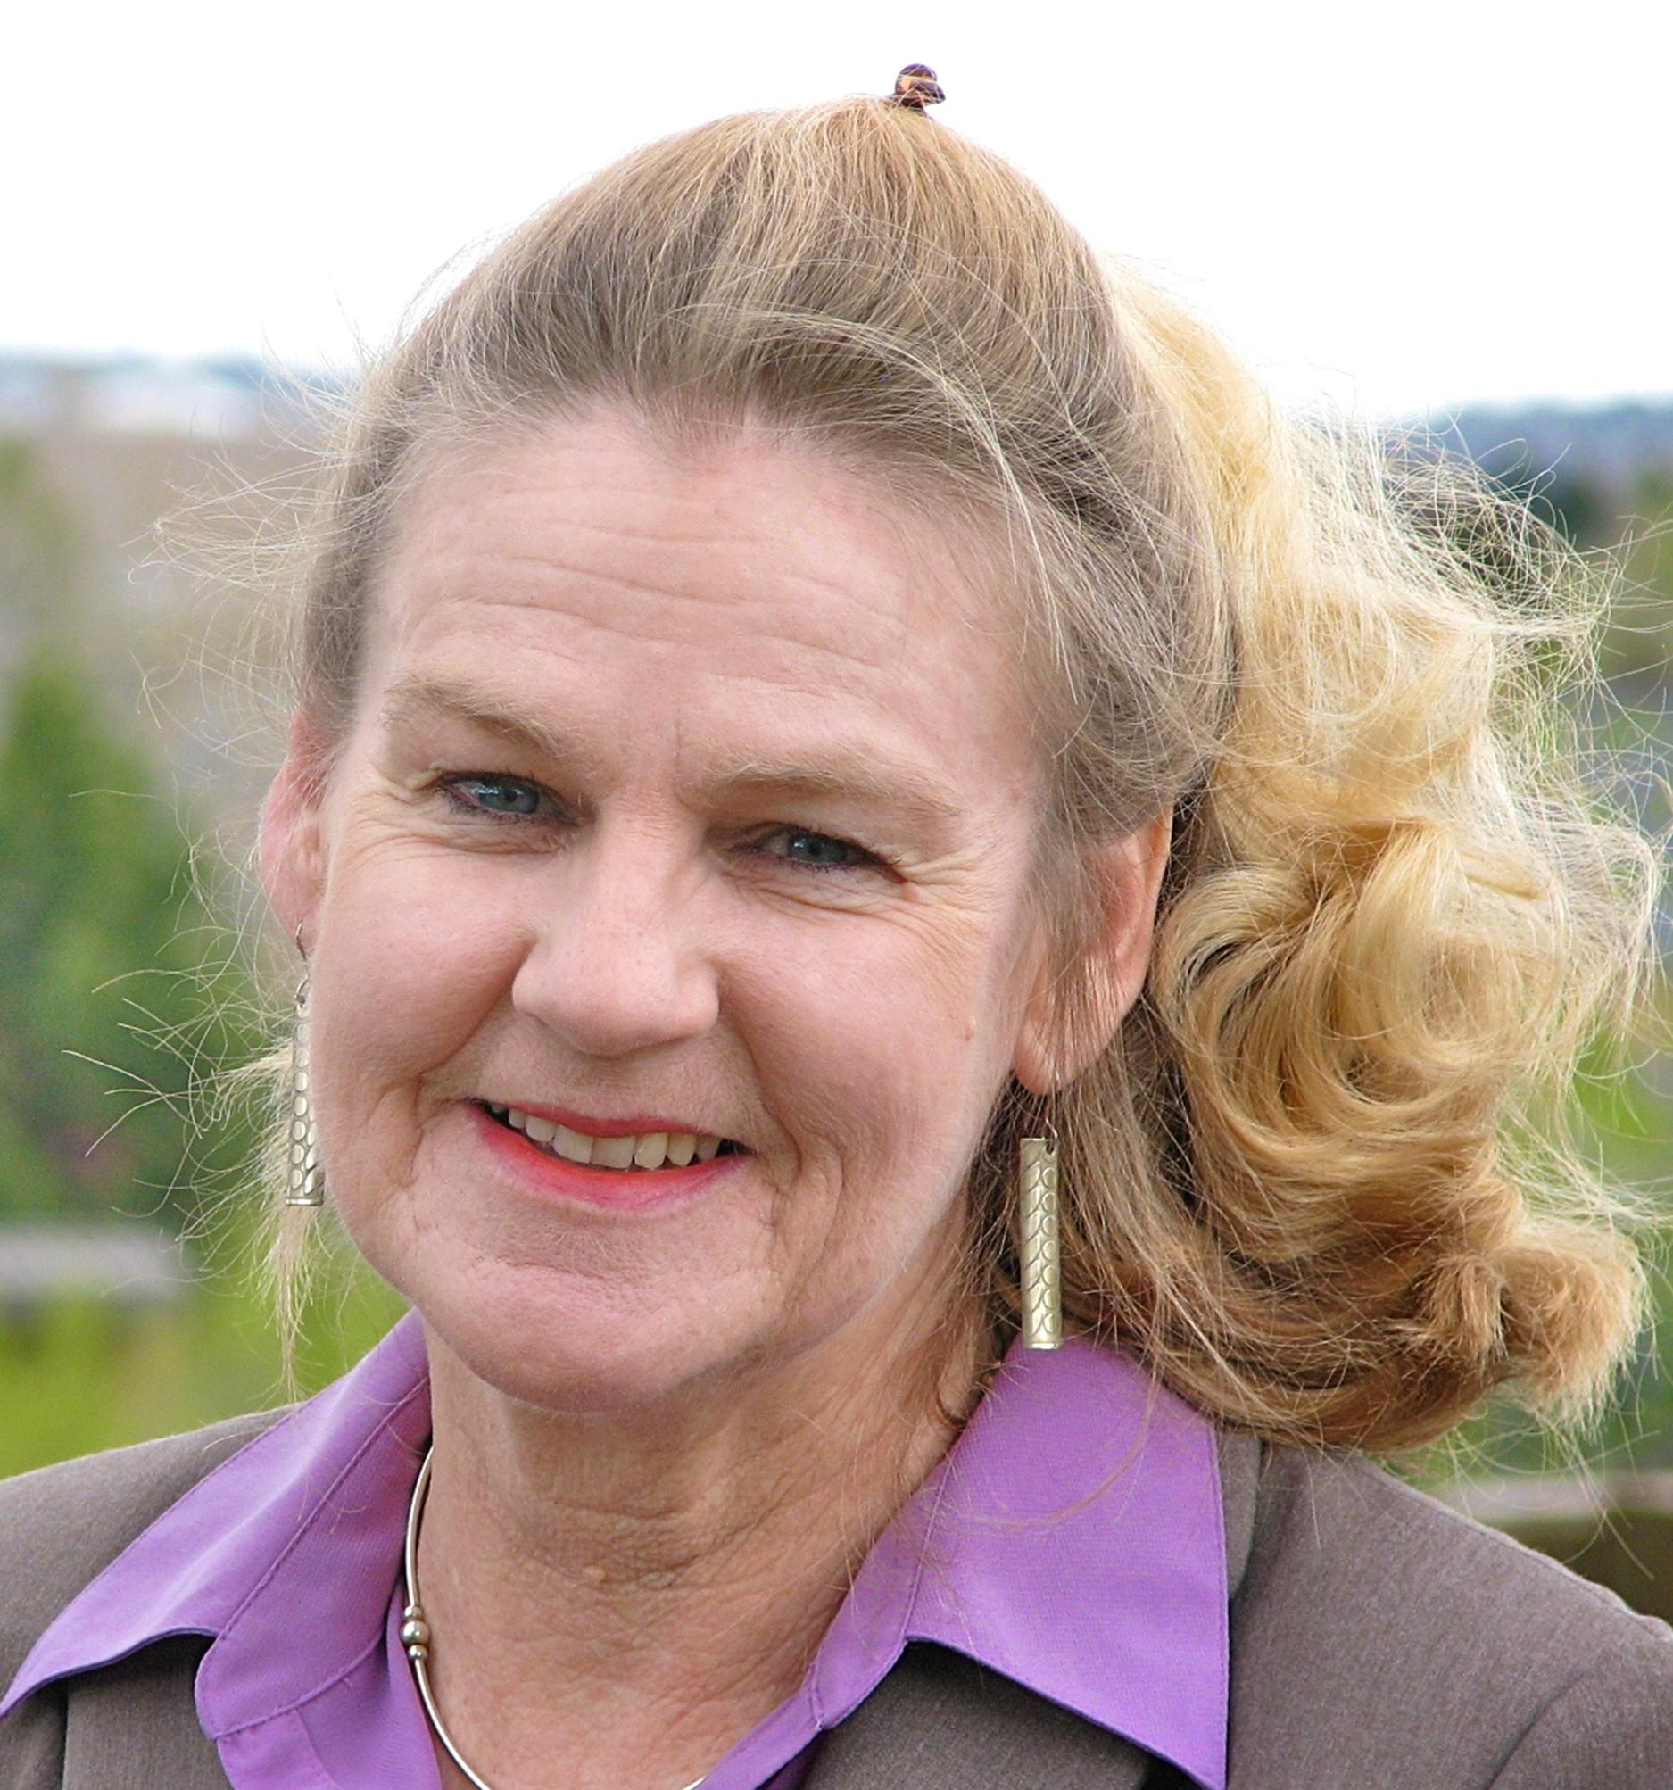
Closing
Join us next month on
July 28 @1pm CST
Betty Barnett
- Youth With A Mission
- Author of Friend Raising: Building a Missionary Support Team That Lasts
Topic: How to Form Lifelong Relationships with Your Support Team

