Slide 1
^{Live online presentations} ^{helping you create a culture} ^{of a fully funded ministry.}

Slide 2
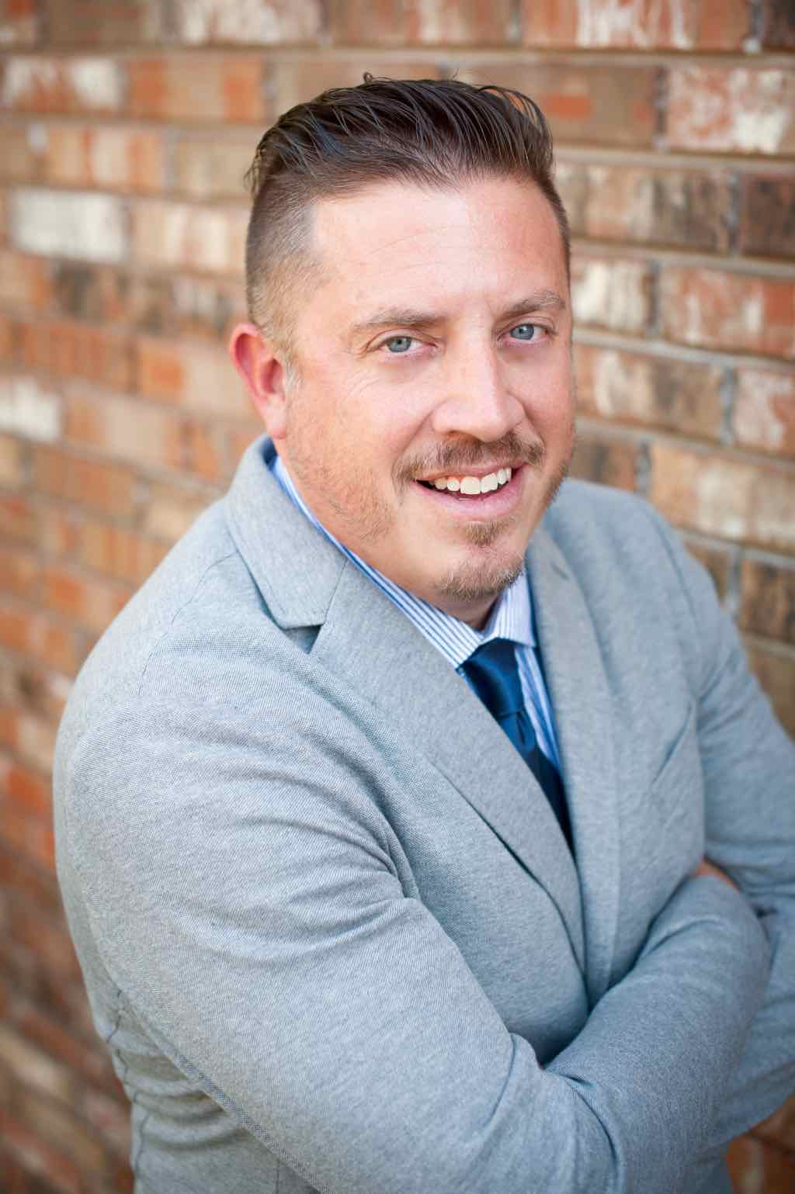
Moderator Introduction
Aaron J. Babyar – SRS Managing Director

Slide 3
Introduction
SRS Vision
We want to flood the nations with
Spiritually healthy,
Vision-driven,
Fully funded Great Commission workers

Slide 4
Introduction
Our Goal
SRS provides solutions to help your staff overcome obstacles, maintain a God-centered perspective, and apply proven strategies to personal support raising.
We want to help you create a culture of a fully funded ministry for:
Recruits
New Staff
Veteran Staff
Support raising trainers and coaches

Slide 5
Introduction
Ongoing Benefits of the SRS Network
Monthly Webinars
Opportunity to utilize SRS Bootcamp curriculum
Audit Survey
Catapult Series
Training for you as facilitators
Facilitator’s Training April 19-20 in
Ft. Lauderdale, FL

Slide 7
Stop and Mark Your Calendar!
Last Tuesday of each month 1 p.m. CST
Please create a recurring event in your calendar
You’ll receive an email invite monthly

Slide 8
^{Prayer}

Slide 9
Questions
During the presentation, please submit your questions for the upcoming Q&A time

Slide 10
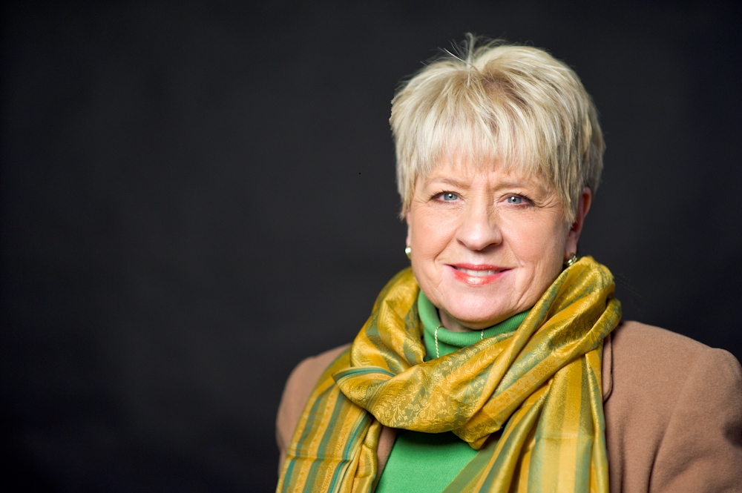
Presenter Introduction
Donna Wilson — InterVarsity

Slide 11
^{Male and Female Differences}
^{In Support Raising}

Slide 12
My Story

Slide 13
My Story
Historical context for the development of standard fundraising practices

Slide 14
My Story
Historical context for the development of standard fundraising practices
Reinventing Fundraising: Realizing the Potential of Women’s Philanthropy by Sondra Shaw and Martha Taylor

Slide 15
Differences in relationship expectations for men and women
Differences

Slide 16
Gender difference in self-perception and cultural socialization that impact emotional responses in support raising
Differences

Slide 17
Differences
Gender difference in self-perception and cultural socialization that impact emotional responses in support raising
Self Doubt vs. Shame

Slide 18
Differences
Gender difference in self-perception and cultural socialization that impact emotional responses in support raising
Self Doubt vs. Shame
Fear of Self Promotion

Slide 19
Differences
Differences in how women and men view giving
Six “C’s” of Women’s Giving (Reinventing Fundraising; Shaw and Taylor)

Slide 20
Differences in how women and men view giving
Change
Differences

Slide 21
Differences in how women and men view giving
Change
Create
Differences

Slide 22
Differences
Differences in how women and men view giving
Change
Create
Connection

Slide 23
Differences
Differences in how women and men view giving
Change
Create
Connection
Commitment

Slide 24
Differences
Differences in how women and men view giving
Change
Create
Connection
Commitment
Collaboration

Slide 25
Differences
Differences in how women and men view giving
Change
Create
Connection
Commitment
Collaboration
Celebration

Slide 26
Differences in cultural and theological understandings about the roles of men and women in the Christian world
Limitations applied to women in spiritual leadership
Differences

Slide 27
Differences
Differences in cultural and theological understandings about the roles of men and women in the Christian world
Limitations applied to women in spiritual leadership
Role expectations for women and mothers

Slide 28
Differences
Differences in cultural and theological understandings about the roles of men and women in the Christian world
Limitations applied to women in spiritual leadership
Role expectations for women and mothers
Support raising in a hierarchical and patriarchal church context

Slide 29
Differences
Differences in cultural and theological understandings about the roles of men and women in the Christian world
Limitations applied to women in spiritual leadership
Role expectations for women and mothers
Support raising in a hierarchical and patriarchal church context
Support raising in patriarchal organizational structures

Slide 30
Differences
Differences in cultural and theological understandings about the roles of men and women in the Christian world
Limitations applied to women in spiritual leadership
Role expectations for women and mothers
Support raising in a hierarchical and patriarchal church context
Support raising in patriarchal organizational structures
Suspicion or discomfort with cross-gender relationships

Slide 31
Ask questions and listen
Coaching Women for Success

Slide 32
Coaching Women for Success
Ask questions and listen
Encourage honesty and thoughtful reflection

Slide 33
Coaching Women for Success
Ask questions and listen
Encourage honesty and thoughtful reflection
Inspire women to act confidently in support raising

Slide 34
Coaching Women for Success
Ask questions and listen
Encourage honesty and thoughtful reflection
Inspire women to act confidently in support raising
Coach women to engage as a professional

Slide 35
Coaching Women for Success
Ask questions and listen
Encourage honesty and thoughtful reflection
Inspire women to act confidently in support raising
Coach women to engage as a professional
Assist women in planning their approach

Slide 36
Coaching Women for Success
Ask questions and listen
Encourage honesty and thoughtful reflection
Inspire women to act confidently in support raising
Coach women to engage as a professional
Assist women in planning their approach
Encourage women to do their homework on theological issues around gender roles

Slide 37
Coaching Women for Success
Ask questions and listen
Encourage honesty and thoughtful reflection
Inspire women to act confidently in support raising
Coach women to engage as a professional
Assist women in planning their approach
Encourage women to do their homework on theological issues around gender roles
Empower the women you coach

Slide 38
Managing Yourself During Support Raising
^{Q&A}
As Leaders and Support Trainers – What to Secure and Establish
Checking on Team Support levels
Staff reporting on support maintenance time
Allocating time for SMD
Share staff experiences

Slide 39
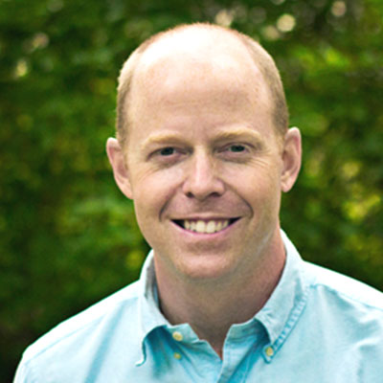
Closing
Join us next month: April 25 at 1 p.m. CST
Tim Casteel
Campus Crusade for Christ

