Slide 1
^{Live online presentations} ^{helping you create a culture} ^{of a fully funded ministry.}

Slide 2
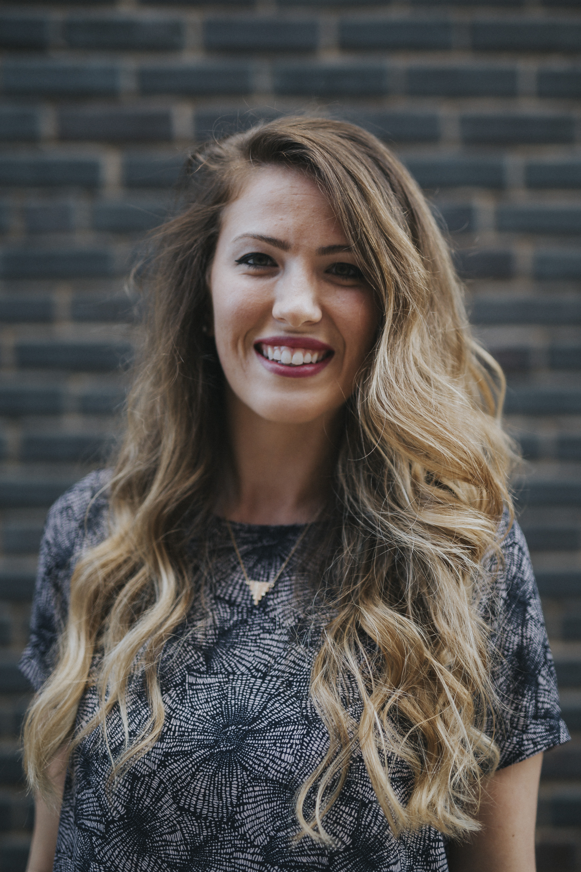
Moderator Introduction
Kayla Murdoch – SRS Communications Manager

Slide 3
Introduction
SRS Vision
We want to flood the nations with
Spiritually healthy,
Vision-driven,
Fully funded Great Commission workers

Slide 4
Introduction
Our Goal
SRS provides solutions to help your staff overcome obstacles, maintain a God-centered perspective, and apply proven strategies to personal support raising.
We want to help you create a culture of a fully funded ministry for:
Recruits
New Staff
Veteran Staff
Support raising trainers and coaches

Slide 5
Introduction
Ongoing Benefits of the SRS Network
Monthly Webinars and Library

Slide 6
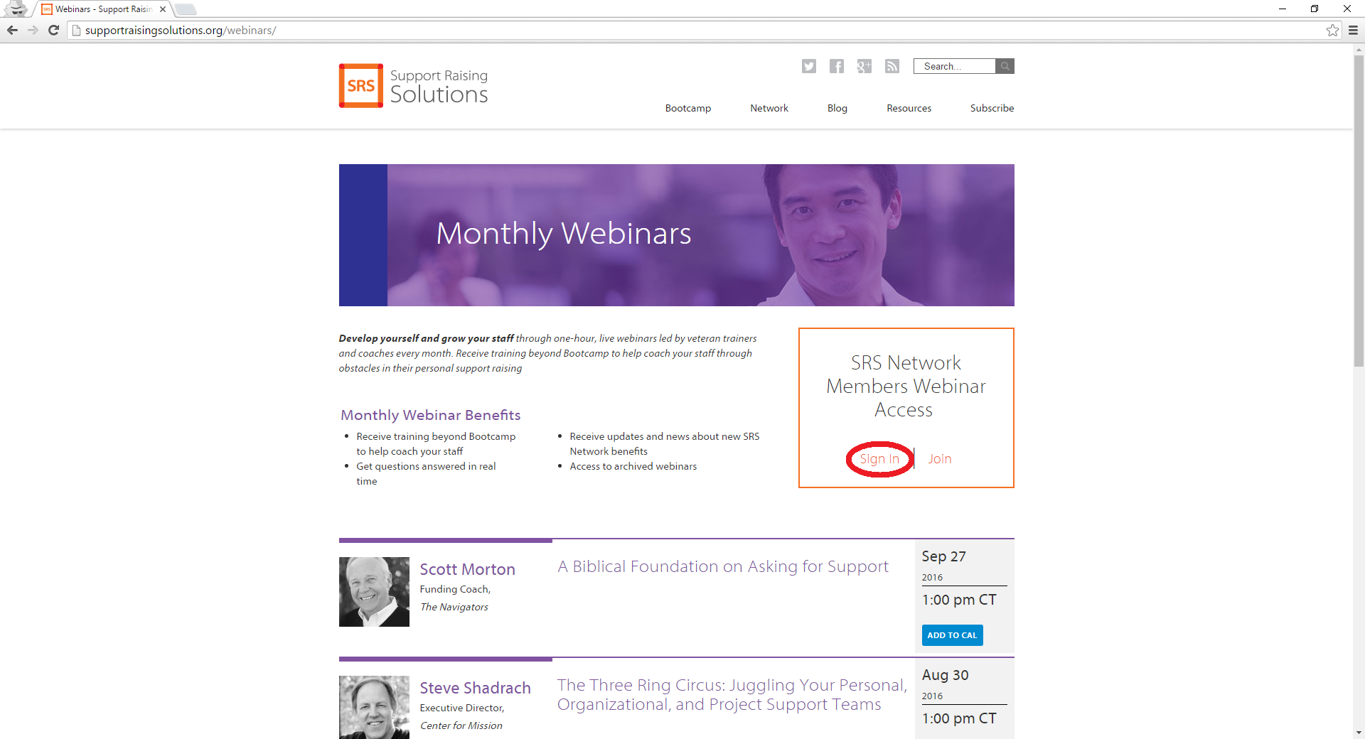
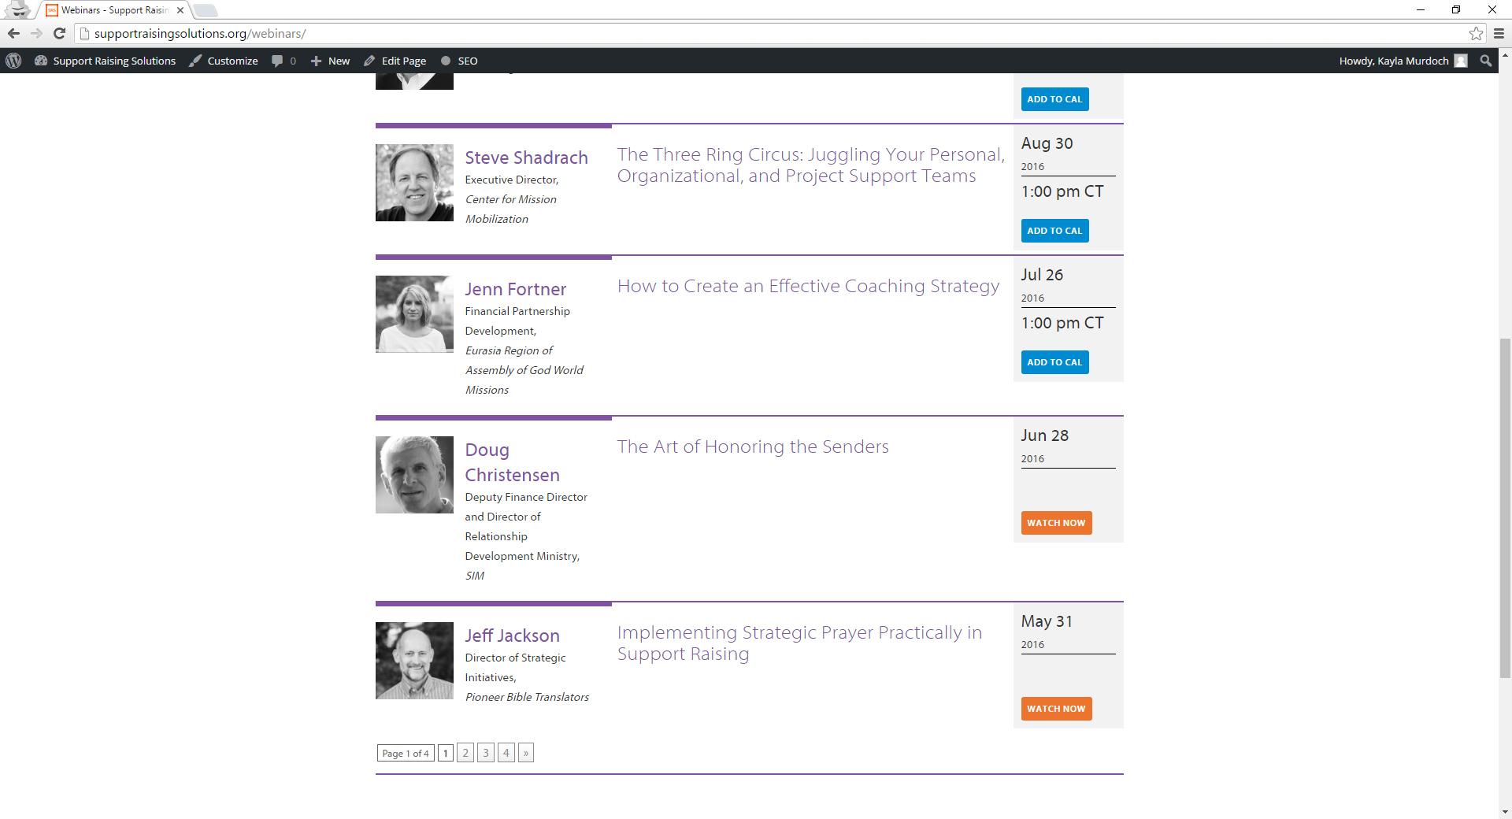
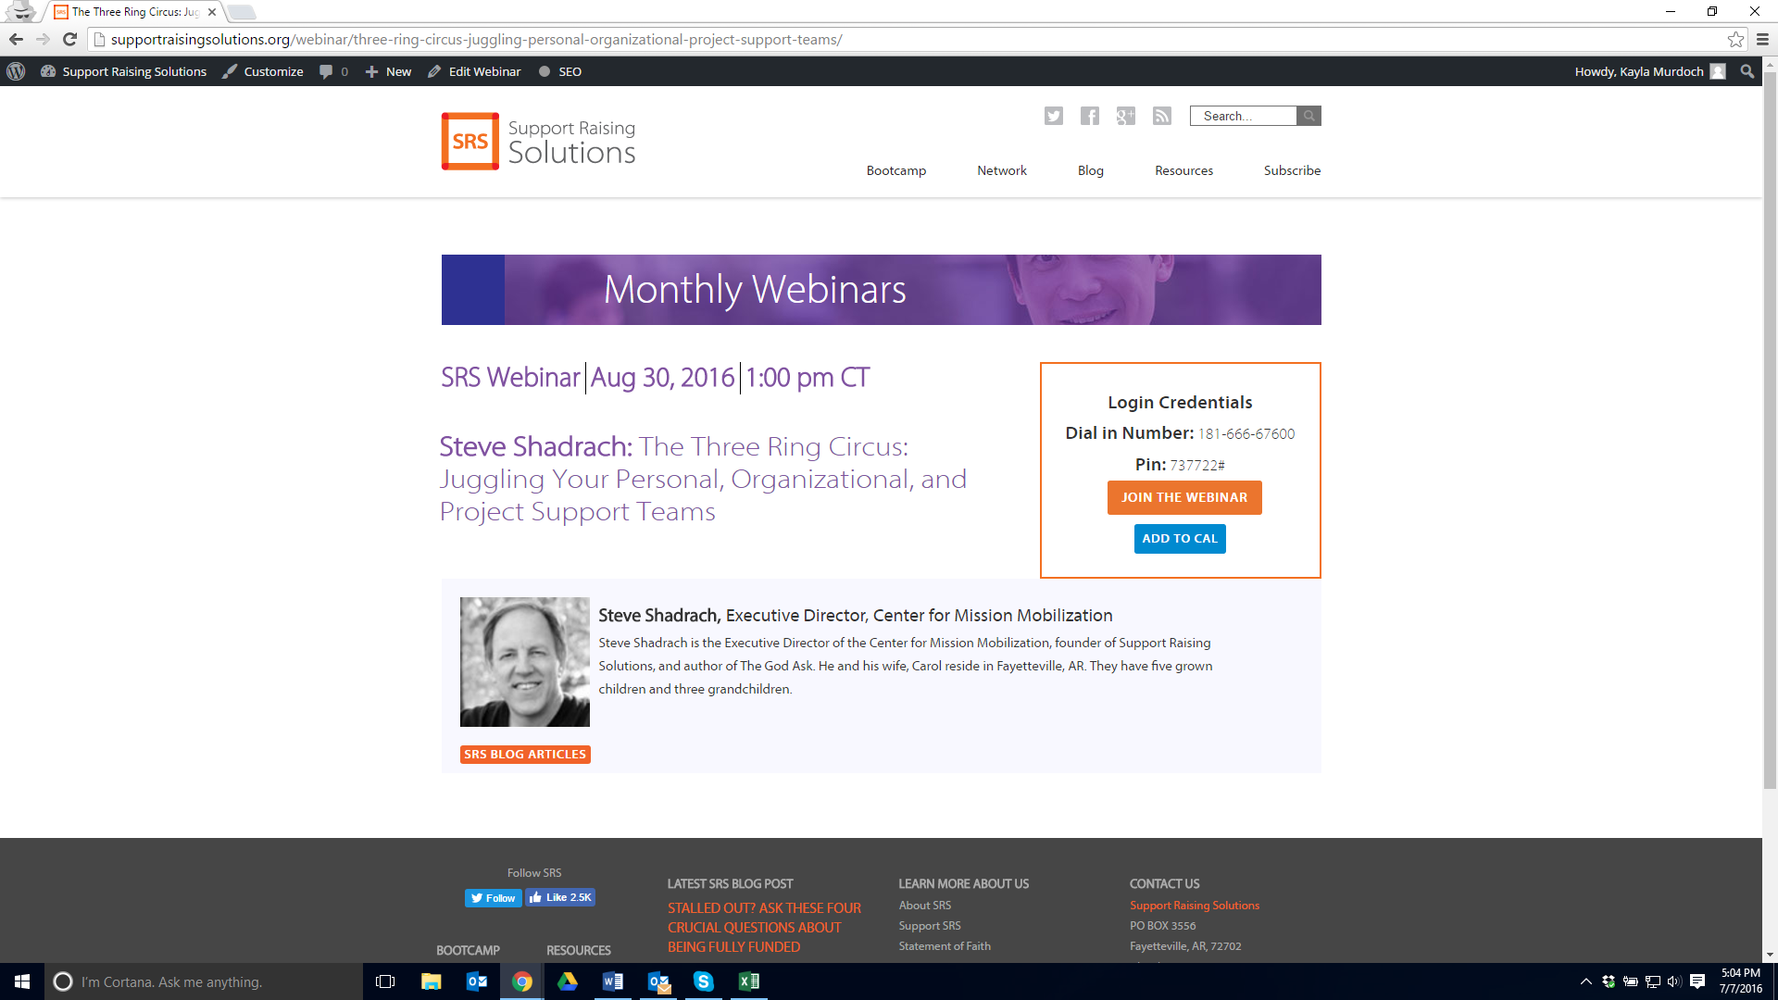
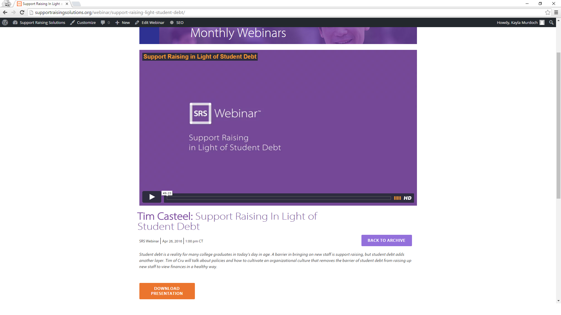
Introduction

Slide 7
Introduction
Ongoing Benefits of the SRS Network
Monthly Webinars and Library
Catapult Series

Slide 8
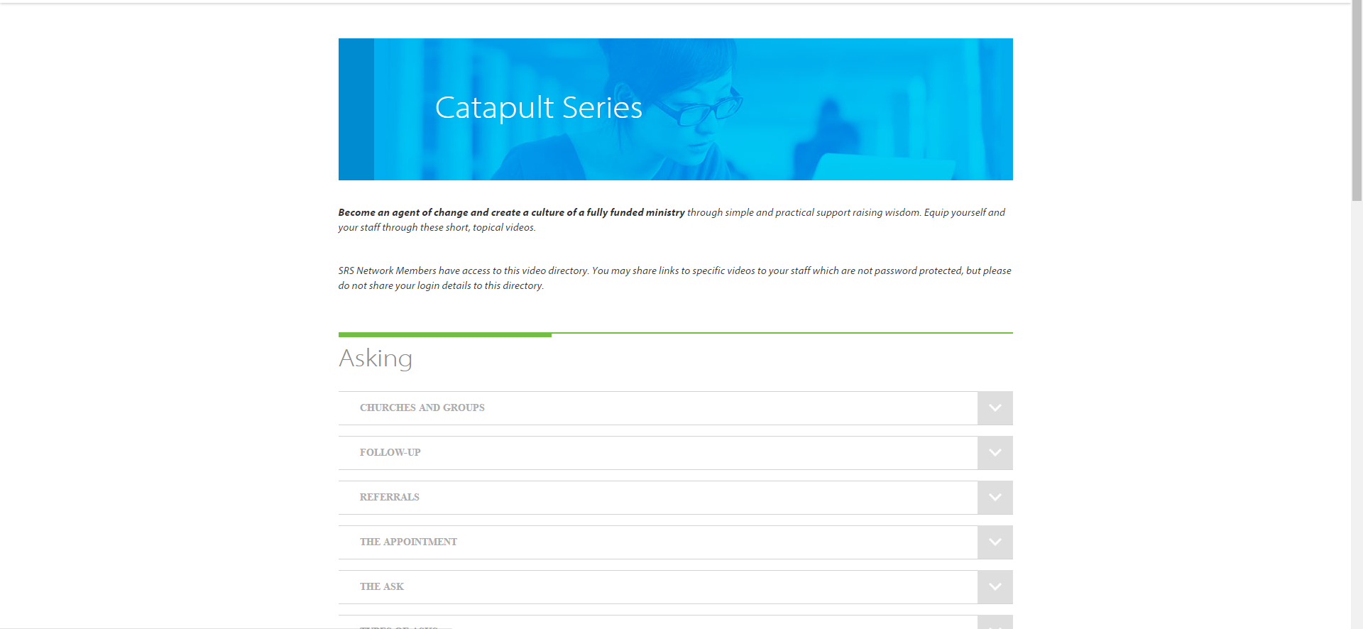

Slide 9
Introduction
Ongoing Benefits of the SRS Network
Monthly Webinars and Library
Catapult Series
Audit Survey
Opportunity to utilize SRS Bootcamp curriculum
Training for you as facilitators
Facilitator’s Training folded in with Support Raising Leaders Conference

Slide 11
Stop and Mark Your Calendar!
Last Tuesday of each month 1 p.m. CST
Please create a recurring event in your calendar
You’ll receive an email invite monthly

Slide 12
^{Prayer}

Slide 13
Questions
During the presentation, please submit your questions for the upcoming Q&A time

Slide 14
Presenter Introduction
Jenn Fortner – Assemblies of God World Missions

Slide 15
^{MPD COACHING 101:}
Practicals, Philosophy of Coaching, and Tips

Slide 16
MPD Coaching 101: The Practicals
1. Calendar-ize and set expectations of when you will talk to those you coach.
Figure out what works for you and your capacity.
Include the following:
Frequency of coaching time
Length of phone call/meeting
Timeframe you will coach them (until they are 100%, until specific date, etc.)

Slide 17
MPD Coaching 101: The Practicals
I personally set these expectations:
Frequency: We connect via phone every two weeks. Set the recurring date to be sometime within office hours: Monday – Friday, 9am-5pm
Length: 10 – 20 minutes, depending on needs
I coach them until they are at 100% fully funded and headed to the field.

Slide 18
MPD Coaching 101: The Practicals
Set clear expectations:
I will be available for questions via email, text, or phone call beyond this bi-weekly appointment, but this is so we can touch base regularly.
I will let you know if I am unable to connect at our designated time prior to the scheduled time via text or email.

Slide 19
MPD Coaching 101: The Practicals
2. Content of Coaching Time
What you accomplished the past two weeks (or duration of time since you last spoke)
What worked?
What didn’t?
Make room for questions on their experiences.
Any wins, frustrations, or road blocks they are experiencing?

Slide 20
MPD Coaching 101: The Practicals
2. Content of Coaching Time (cont.)
What your goals are for the next two weeks
Make sure they align with overall goals (set first time you talked)
Fill in any holes if they don’t know what their goals should be. (i.e. if they aren’t specific enough make them more specific, if they aren’t reasonable talk about that, if they aren’t enough ask if maybe they should do more)
Ask if they have any specific questions

Slide 21
MPD Coaching 101: The Practicals
In Short
Overall goals
Last two weeks
Next two weeks
Questions

Slide 22
MPD Coaching 101: The Practicals
2. Content of Coaching Time (cont.)
When setting goals make sure they are
Relevant
Specific
Measurable
Attainable (can they accomplish the goals? Do they have the capacity? Are they selling themselves short because of fear?)
Make a suggestion of goals that work for others who do MPD. I suggest a beginning goal of making 10 initial contacts per week, plus incorporation of churches, regular thank yous', and correspondence.

Slide 23
MPD Coaching 101: The Practicals
2. Content of Coaching Time (cont.)
Ask if they have goals they are already committed to.
Let the client be the one in the driver’s seat in setting their own goals.

Slide 24
MPD Coaching 101: The Practicals
3. In your first coaching time, tell them about yourself and how coaching works.
Remind them of expectations of your time together (i.e. we will talk on the phone, I’ll ask you about your goals and what you have accomplished with you, and troubleshoot and answer questions)
Tell them about your background and why you love coaching.

Slide 25
MPD Coaching 101: The Practicals
3. In your first coaching time, tell them about yourself and how coaching works. (cont.)
Tell them you want to be available for them how you can. Set parameters on that based on your capacity. *mine is dedicated, so I tell them to please ask me anything whenever.
Ask if they have questions about anything at all.

Slide 26
MPD Coaching 101: The Practicals
4. Take notes and review them before your next scheduled coaching time.
Find a way to take notes on every coaching session. I write down the following:
What was accomplished in the past two weeks
Not accomplished goals
Next two week’s worth of goals
Reminders: to ask them about ____ next time.
We write ours in a CRM called Nutshell. I log in about 5-10 minutes before I coach a person and review the notes from the last time. Typically I copy and paste them into the new notes and work from there…the notes lead my conversations. If you don’t have a CRM, create a google document or a place you can go to for every time you coach.

Slide 27
MPD Coaching 101: The Practicals
4. Take notes and review them before your next scheduled coaching time. (cont.)
Stay consistent
You can’t ask them to set goals and follow through with them if you don’t.
Make sure you are available for every appointment and communicate if something comes up and you need to make a time change.

Slide 28
MPD Coaching 101: The Practicals
5. If they don’t answer, log it and eventually try a different method if need be.
If you have someone who doesn’t answer their phone on a regular basis, log it in your notes.
If you have more than one time they do not answer then try emailing, Facebooking, or texting and asking if there needs to be another time set up…or if they could perhaps email you an update for that week.

Slide 29
MPD Coaching 101: The Practicals
6. Be flexible and open yourself up to questions whenever.
Some people need to do things a little differently than your formula. Try to accommodate when you can.
Remain flexible. If they need to call you back at another time or text you with a question try to accommodate.
Build rapport with them. Show them what good communication looks like.

Slide 30
^{Coaching Philosophy}

Slide 31
MPD Coaching 101: Coaching Philosophy
“A coach pushes you to think, stretch yourself, to take responsibility for your life and get done what you know you need to do. A coach is also someone who will hold you accountable, challenge you to live our your values or occasionally give you a swift kick in the pants when you need it.”
- Leadership Coaching, by Tony Stoltzfus

Slide 32
MPD Coaching 101: Coaching Philosophy
Coaching is primarily about believing in people. Have positive things to say and positive feedback. (even when you are doing a swift kick in the pants)

Slide 33
MPD Coaching 101: Coaching Philosophy
Let the client set the agenda. Don’t set it for them. When setting goals, make suggestions, but ultimately it is something they have to own.

Slide 34
MPD Coaching 101: Coaching Philosophy
Give as little advice as possible and make few suggestions.
Basic principle to remember: being motivated to make a change is more important than knowing what change to make.
Anyone can tell me what I ought to do; but internal motivation can only come from within me.
Typically, we know what we need to work on. Let the client lead you to what that is.
Coaching approaches of listening and asking questions is more effective at fostering change than the advice-giving approach.

Slide 35
Coaching Tips

Slide 36
MPD Coaching 101: Coaching Tips
Every person is different and may need different goals. Therefore be willing to accommodate and listen. Seek to understand the nuances in each person you coach.
Notes:
I have served with SIM in a variety of roles and locations – but because of my CPA background, it has generally involved Financial Administration
I oversee a team that manages the support budgets and expense reimbursements for our overseas long term and short missionaries, new appointees, home staff, retirees, and associate volunteers, When a missionary is short on support, I am generally one of the first people to know. SIM has a pooling system that provides short term assistance when there is a financial need. It hurts when we have to put a missionary on a reduced budget due to low support. That’s why I care for our missionaries, and it’s why I am a trainer to help them build and maintain a full prayer and financial support team.
Trends: Several years ago, support from churches comprised 40% or more of a missionaries support. It was common for a missionary to have 6, 10 or even 20 supporting churches. Now we see a trend of missionaries having fewer church and more intimate relationships with these churches and individual financial partners
Why do they give?
Relationship – with God and the faith supported worker. They view giving as part of our worship
Cause – Give to invest in God’s kingdom. They want to be involved in our Father’s work and great commission

Slide 37
MPD Coaching 101: Coaching Tips
Pray for your clients regularly, not only while you are on the phone with them.
Stay organized.
Notes:
I have served with SIM in a variety of roles and locations – but because of my CPA background, it has generally involved Financial Administration
I oversee a team that manages the support budgets and expense reimbursements for our overseas long term and short missionaries, new appointees, home staff, retirees, and associate volunteers, When a missionary is short on support, I am generally one of the first people to know. SIM has a pooling system that provides short term assistance when there is a financial need. It hurts when we have to put a missionary on a reduced budget due to low support. That’s why I care for our missionaries, and it’s why I am a trainer to help them build and maintain a full prayer and financial support team.
Trends: Several years ago, support from churches comprised 40% or more of a missionaries support. It was common for a missionary to have 6, 10 or even 20 supporting churches. Now we see a trend of missionaries having fewer church and more intimate relationships with these churches and individual financial partners
Why do they give?
Relationship – with God and the faith supported worker. They view giving as part of our worship
Cause – Give to invest in God’s kingdom. They want to be involved in our Father’s work and great commission

Slide 38
MPD Coaching 101: Coaching Tips
Learn to ask broad questions. Asking the right questions can be vital because it frames where the client will take the conversation.
Don’t place restrictions or conditions on your questions.
Notes:
I have served with SIM in a variety of roles and locations – but because of my CPA background, it has generally involved Financial Administration
I oversee a team that manages the support budgets and expense reimbursements for our overseas long term and short missionaries, new appointees, home staff, retirees, and associate volunteers, When a missionary is short on support, I am generally one of the first people to know. SIM has a pooling system that provides short term assistance when there is a financial need. It hurts when we have to put a missionary on a reduced budget due to low support. That’s why I care for our missionaries, and it’s why I am a trainer to help them build and maintain a full prayer and financial support team.
Trends: Several years ago, support from churches comprised 40% or more of a missionaries support. It was common for a missionary to have 6, 10 or even 20 supporting churches. Now we see a trend of missionaries having fewer church and more intimate relationships with these churches and individual financial partners
Why do they give?
Relationship – with God and the faith supported worker. They view giving as part of our worship
Cause – Give to invest in God’s kingdom. They want to be involved in our Father’s work and great commission

Slide 39
Managing Yourself During Support Raising
^{Q&A}
As Leaders and Support Trainers – What to Secure and Establish
Checking on Team Support levels
Staff reporting on support maintenance time
Allocating time for SMD
Share staff experiences

Slide 40
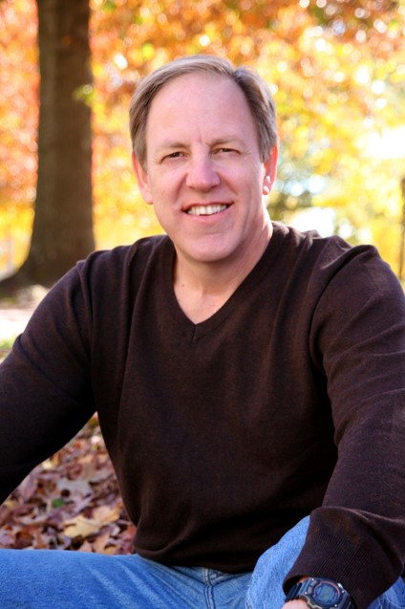
Closing
Join us next month: August 30 at 1 p.m. CST
Steve Shadrach
Center for Mission Mobilization

